Slide 1
Traffic Sign Image Classification
CMPE 255 - Project Presentation
Advisor: Dr. Gheorghi Guzun
Poojitha Amin (011811306)
Krutika Mude (012535094)
Suraj Khurana (011464427)

Slide 2
OBJECTIVE
Build an image recognizer to classify the traffic signs.
Explore image pre-processing techniques.
Learn about object detection techniques in an image.
Experiment with different model building and evaluation approaches.

Slide 3
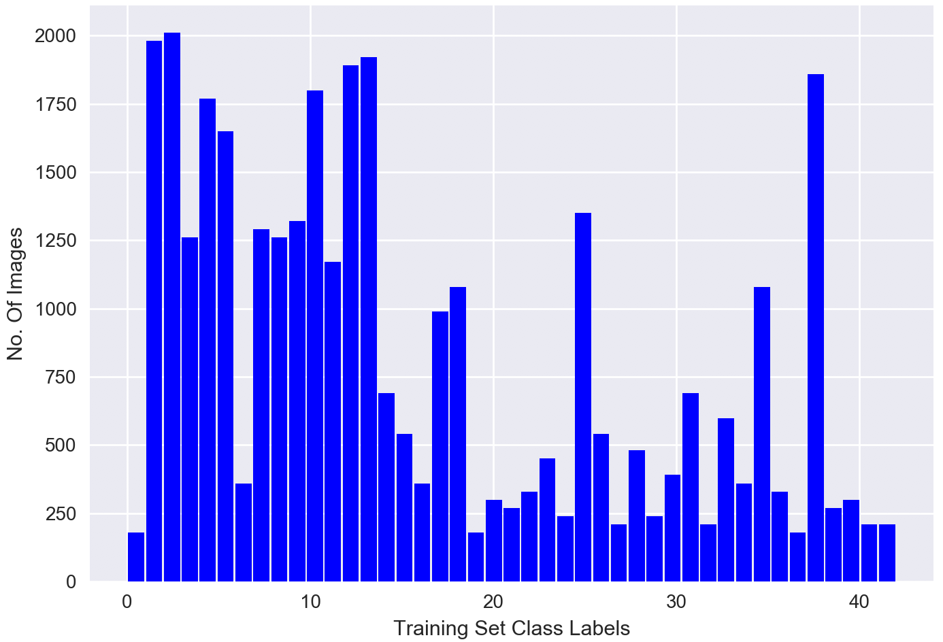
DATASET
More than 50,000 images
43 Classes
Varying image sizes 15x15 to 250x250
Imbalanced Classes

Slide 4
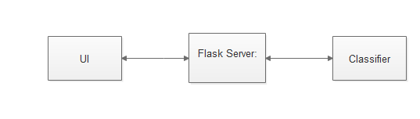
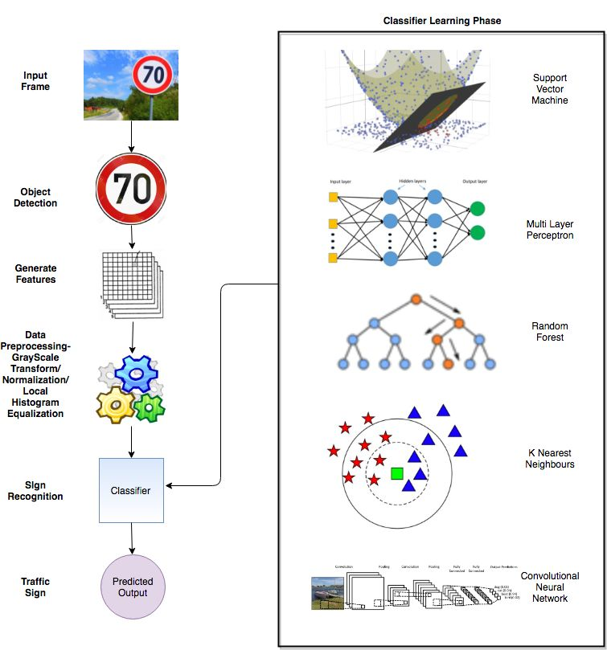
ARCHITECTURE AND SYSTEM DESIGN

Slide 5
OBJECT DETECTION
Approach 1:
Using convolutional neural network.
Translational Invariance.
Approach 2:
Base Idea of Image Thresholding
Threshold stark sign Board color
Smoothen and Blur Out Image to resolve graininess of Image
Detect contours , and select one having sizeable area
Crop original image, with the bound of the contour.

Slide 6
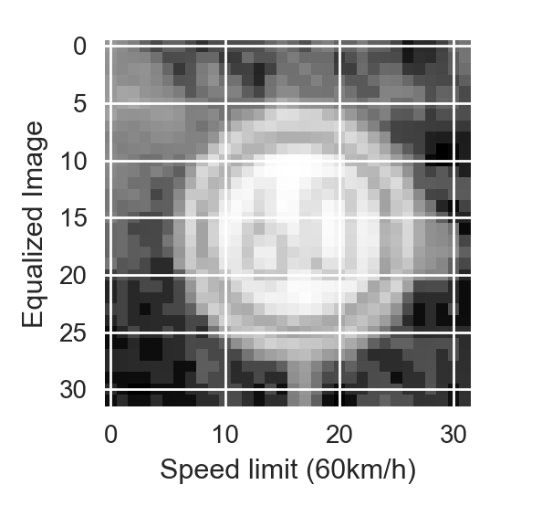
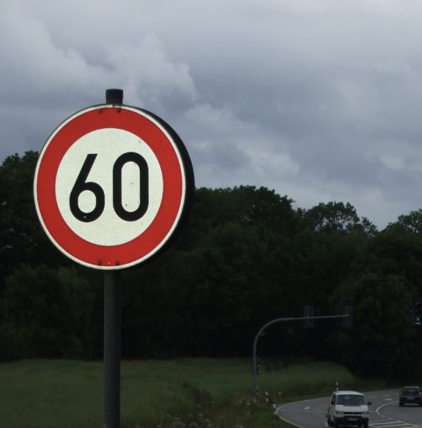
IMAGE PRE-PROCESSING
Gray Scale Transformation : Reduces Dimensions 3 times.
Local Histogram Equalization : Improve contrast, for better edge detection.
Image Normalization : Normalise the pixel intensity.
Image Blurring : To remove grainy images, for obtaining good bounding box.
Anti Aliasing : Smoothing jagged ends for low quality images.

Slide 7
MACHINE LEARNING ALGORITHMS
MLP Classifier - in Essence , a CNN.
LinearSVC - SVM performs well with Image classification.
Random Forests - Quick to build and Classify.
Keras CNN - The Deep Learner Model.

Slide 8
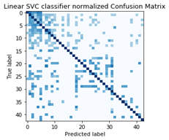
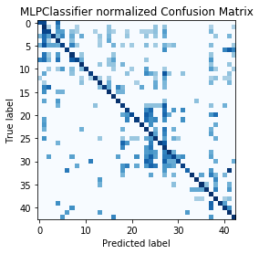
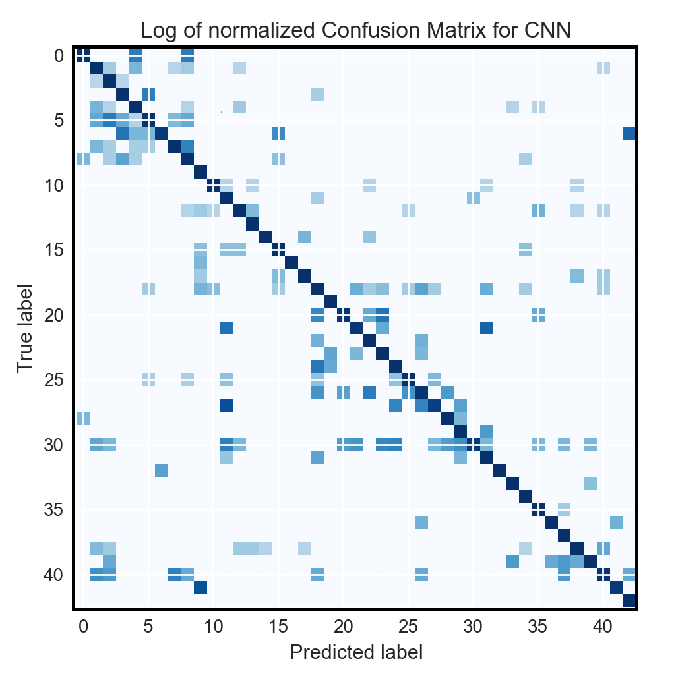


GRAPHS AND ANALYSIS

Slide 9
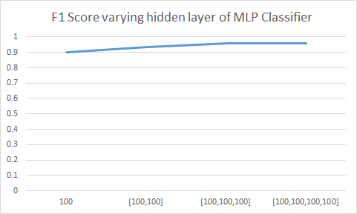
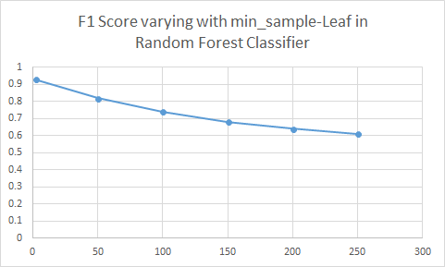
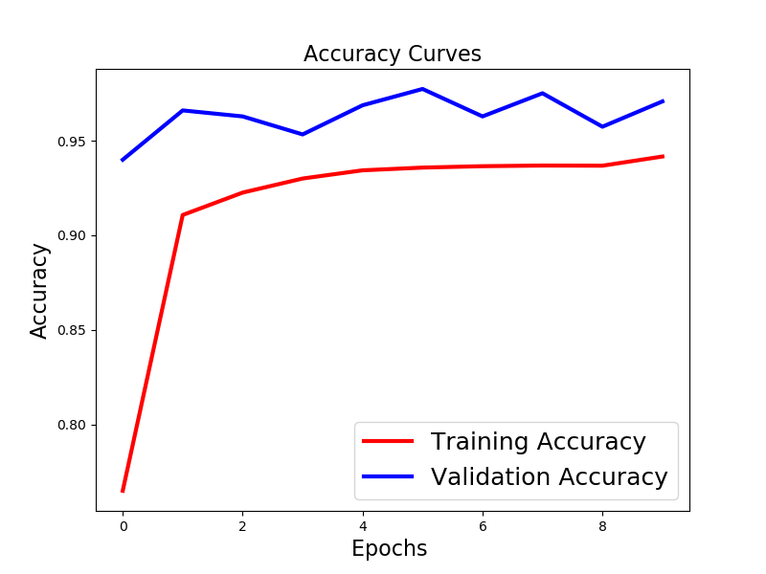
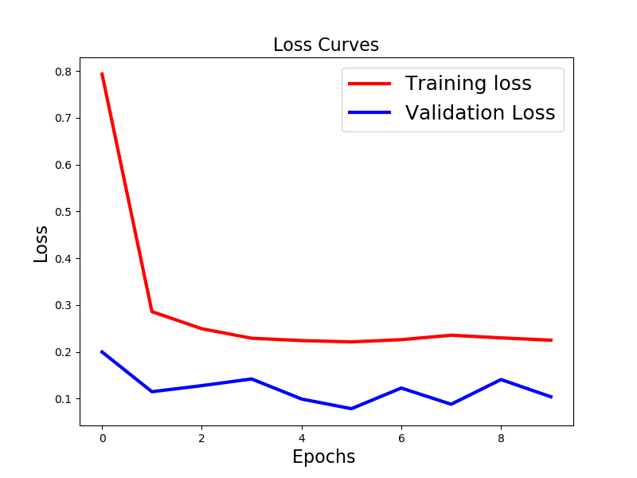
PARAMETERS TUNING
CNN Accuracy and Loss curves

Slide 10
RESULTS
Model | F1-Score | Training Time
MLP Classifier | 0.972 | 0:02:31
Random Forest | 0.939 | 0:00:07
Linear SVM | 0.926 | 00:47:25
KNN | 0.88 | 01:50:52
Keras CNN | 0.983 | 00:20:00

